Slide 1
Uva 10599
Robots(II)
Time: 3 seconds

Slide 2
Problem Descriptions(1/5)
Your company provides robots that can be used to pick up litter from fields after sporting events and concerts.
Before robots are assigned to a job, an aerial photograph of the field is marked with a grid.
Each location in the grid that contains garbage is marked. All robots begin in the Northwest corner and end their movement in the Southeast corner.

Slide 3
Problem Descriptions(2/5)
A robot can only move in two directions, either to the East or South. Upon entering a cell that contains garbage, the robot can be programmed to pick it up before proceeding.
Once a robot reaches its destination at the Southeast corner it cannot be repositioned or reused.
Since your expenses are directly proportional to the number of robots used for a particular job, you are interested in making the most out of them.

Slide 4
Problem Descriptions(3/5)
Your task would be to use a robot to clean the maximum number of cells containing garbage.
Now there can be many ways to do this job, so your task would be to report that number of ways and show us one such sample.

Slide 5
Problem Descriptions(4/5)
You see your robot can traverse many cells without picking up garbage, so for us a valid solution would be the sequence of cell numbers that the robot cleans.
The robots only clean cells that contain garbage; but you can program them to avoid picking up garbage from specific cells, if you would want to.

Slide 6
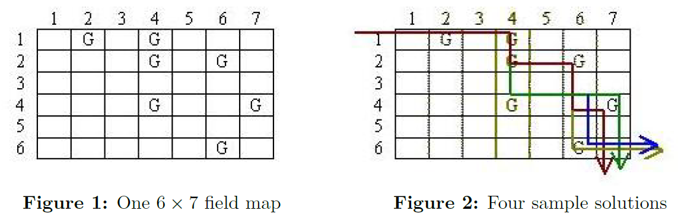
Problem Descriptions(5/5)
2
4
< 2, 4, 11, 13, 28 >
< 2, 4, 11, 13, 41 >
< 2, 4, 11, 25, 28 >
< 2, 4, 11, 25, 41 >
11
13
25
28
41
In the figure above we show a field map that has 6 rows and 7 columns. The cells in a field map are numbered in row major order starting from 1. For the example shown here, the following 7 cells contain garbage: 2 (1,2), 4 (1,4), 11 (2, 4), 13 (2, 6), 25 (4, 4), 28 (4, 7) and 41 (6, 6). Here cells are presented in cell_number (row, column) format. Now the maximum number of cells that can be cleaned is 5, and there are four different ways to do that:

Slide 7
Input (1/2)
An input file consists of one or more field maps followed by a line containing ‘-1 -1’ to signal the end of the input data.
The description of a field map starts with the number of rows and the number of columns in the grid. Then in the subsequent lines, the garbage locations follows. The end of a field map is signaled by ‘0 0’.
Each garbage location consists of two integers, the row and column, separated by a single space. The rows and columns are numbered as shown in Figure 1.

Slide 8
Input (2/2)
The garbage locations will not be given in any specific order. And a location would not be reported twice for a field map.
Please note that for all the test cases you are required to solve, the field map would be of at most 100 rows and 100 columns.

Slide 9
Output (1/2)
The output for each test case starts with the serial number (starting from 1) for that test case.
Then the following integers are listed on a line:
N the maximum number of cells that the robot can clean,
C the number of ways that these N cells can be cleaned
N numbers describing one possible sequence of cell numbers that the robot will clean.

Slide 10
Output (2/2)
As there can be C different such sequences and we are asking for only one sequence any valid sequence would do.
Make sure that all these 2 + N integers for a test case are printed on a single line.
There must be one space separating two consecutive integers and a space between the colon and the first integer on the line.
See the sample output format for a clear idea.

Slide 11
Sample Input / Output
row, column
N, Number of cells canbe cleaned
6 7
1 2
1 4
2 4
2 6
4 4
4 7
6 6
0 0
4 4
1 1
2 2
3 3
4 4
0 0
-1 -1
CASE#1: 5 4 2 4 11 13 28
CASE#2: 4 1 1 6 11 16
Garbage location
C, Number of ways that
N cells canbe cleaned
End of field map
End of field map

Slide 12
Longest Increasing Subsequence
Problem a sequence {x[0], x[1],…,x[n-1]}, determine its Longest Increasing Subsequence.
Example: n=8
X = {9, 5, 2, 8, 7, 3, 1, 6,4}
LIS is {2, 3, 6} or {2,3,4}, lenngth=3.

Slide 13
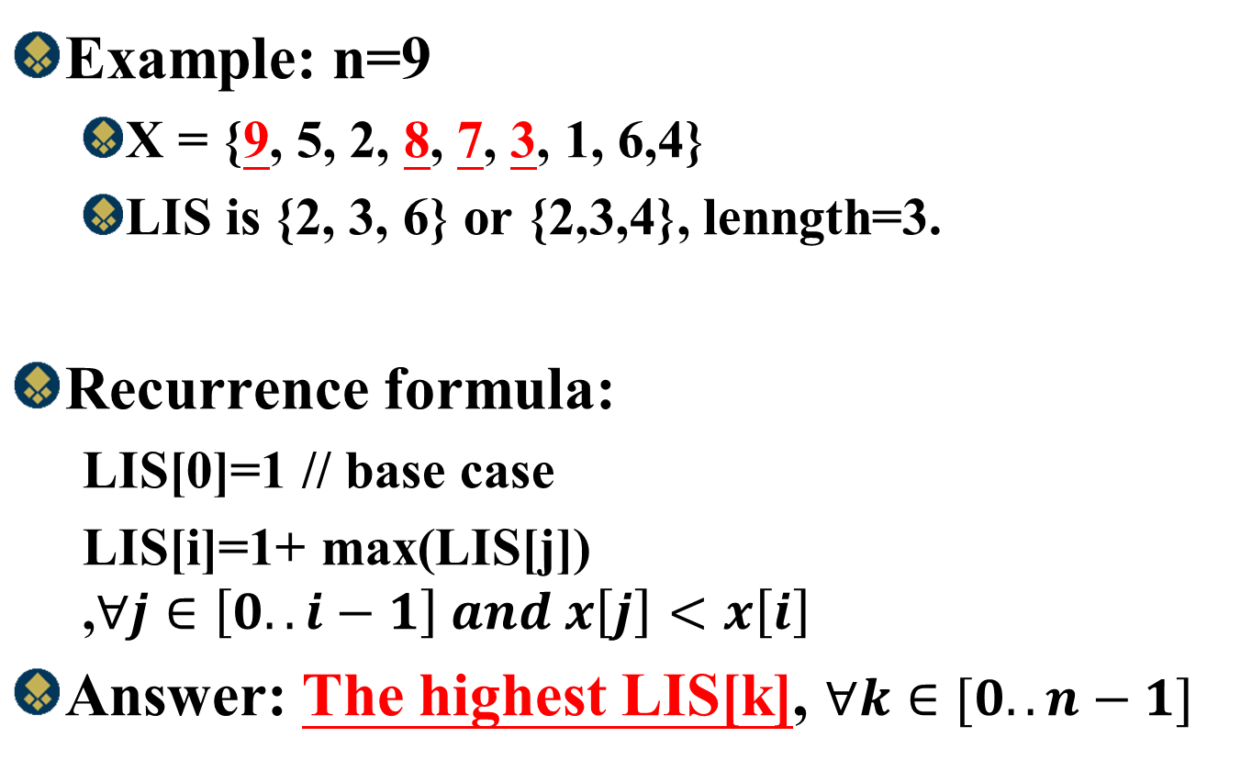
Longest Increasing Subsequence
Example: n=9
X = {9, 5, 2, 8, 7, 3, 1, 6,4}
LIS is {2, 3, 6} or {2,3,4}, lenngth=3.
Recurrence formula:
LIS[0]=1 // base case
LIS[i]=1+ max(LIS[j]) ,$∀j∈\left[0..i−1\right] and x\left[j\right]<x\left[i\right]$
Answer: The highest LIS[k], $∀k∈[0..n−1]$

Slide 14
Example
Example: n=9
X = {9, 5, 2, 8, 7, 3, 1, 6,4}
Length=3
index | 0 | 1 | 2 | 3 | 4 | 5 | 6 | 7 | 8
X | 9 | 5 | 2 | 8 | 7 | 3 | 1 | 6 | 4
LIS[0] | 1
LIS[1] | 1 | 1
LIS[2] | 1 | 1 | 1
LIS[3] | 1 | 1 | 1 | 2
LIS[4] | 1 | 1 | 1 | 2 | 2
LIS[5] | 1 | 1 | 1 | 2 | 2 | 2
LIS[6] | 1 | 1 | 1 | 2 | 2 | 2 | 1
LIS[7] | 1 | 1 | 1 | 2 | 2 | 2 | 1 | 3
LIS[8] | 1 | 1 | 1 | 2 | 2 | 2 | 1 | 3 | 3
Final | 1 | 1 | 1 | 2 | 2 | 1 | 1 | 3 | 3

Slide 15
Example
Example: n=9
X = {9, 5, 2, 8, 7, 3, 1, 6,4}
Length=3
index | 0 | 1 | 2 | 3 | 4 | 5 | 6 | 7 | 8
X | 9 | 5 | 2 | 8 | 7 | 3 | 1 | 6 | 4
LIS[0] | 1
LIS[1] | 1 | 1
LIS[2] | 1 | 1 | 1
LIS[3] | 1 | 1 | 1 | 2
LIS[4] | 1 | 1 | 1 | 2 | 2
LIS[5] | 1 | 1 | 1 | 2 | 2 | 2
LIS[6] | 1 | 1 | 1 | 2 | 2 | 2 | 1
LIS[7] | 1 | 1 | 1 | 2 | 2 | 2 | 1 | 3
LIS[8] | 1 | 1 | 1 | 2 | 2 | 2 | 1 | 3 | 3
Final | 1 | 1 | 1 | 2 | 2 | 1 | 1 | 3 | 3

Slide 16
Example
Example: n=9
X = {9, 5, 2, 8, 7, 3, 1, 6,4}
Length=3
index | 0 | 1 | 2 | 3 | 4 | 5 | 6 | 7 | 8
X | 9 | 5 | 2 | 8 | 7 | 3 | 1 | 6 | 4
LIS[0] | 1
LIS[1] | 1 | 1
LIS[2] | 1 | 1 | 1
LIS[3] | 1 | 1 | 1 | 2
LIS[4] | 1 | 1 | 1 | 2 | 2
LIS[5] | 1 | 1 | 1 | 2 | 2 | 2
LIS[6] | 1 | 1 | 1 | 2 | 2 | 2 | 1
LIS[7] | 1 | 1 | 1 | 2 | 2 | 2 | 1 | 3
LIS[8] | 1 | 1 | 1 | 2 | 2 | 2 | 1 | 3 | 3
Final | 1 | 1 | 1 | 2 | 2 | 1 | 1 | 3 | 3

Slide 17

Time Complexityy
Recurrence formula:
LIS[0]=1 // base case
LIS[i]=1+ max(LIS[j]) ,$∀j∈\left[0..i−1\right] and x\left[j\right]<x\left[i\right]$
Answer: The highest LIS[k], $∀k∈[0..n−1]$
O(n²)
O(n)
Find Length:O(n)+O(n²)=O(n²)
Find LIS subsequence: O(n)

Slide 18
Example
Example: n=9
X = {9, 5, 2, 8, 7, 3, 1, 6,4}
Length=3
index | 0 | 1 | 2 | 3 | 4 | 5 | 6 | 7 | 8
X | 9 | 5 | 2 | 8 | 7 | 3 | 1 | 6 | 4
LIS[0] | 1
LIS[1] | 1 | 1
LIS[2] | 1 | 1 | 1
LIS[3] | 1 | 1 | 1 | 2
LIS[4] | 1 | 1 | 1 | 2 | 2
LIS[5] | 1 | 1 | 1 | 2 | 2 | 2
LIS[6] | 1 | 1 | 1 | 2 | 2 | 2 | 1
LIS[7] | 1 | 1 | 1 | 2 | 2 | 2 | 1 | 3
LIS[8] | 1 | 1 | 1 | 2 | 2 | 2 | 1 | 3 | 3
Final | 1 | 1 | 1 | 2 | 2 | 1 | 1 | 3 | 3
{9(1)}
{5(1)}
{2(1)}
{2(1), 8(2)}
{2(1), 7(2)}
{2(1), 3(2)}
{1(1), 3(2)}
{1(1), 3(2),6(3)}
{1(1), 3(2),4(3)}

Slide 19
Time Complexityy
K is the length of LIS
Recurrence formula:
LIS[0]=1 // base case
LIS[i]=1+ max(LIS[j]) ,$∀j∈\left[0..i−1\right] and x\left[j\right]<x\left[i\right]$
Answer: The highest LIS[k], $∀k∈[0..n−1]$
O(nlogk)
Find Length:O(n)+O(nlogk)=O(nlogk)
Find LIS subsequence: O(n)

Slide 20
Solution (1)
row=6, col=7
2
4
< 2, 4, 11, 13, 28 >
< 2, 4, 11, 13, 41 >
< 2, 4, 11, 25, 28 >
< 2, 4, 11, 25, 41 >
11
13
25
28
41
j
i
A
0 | 1 | 2 | 3 | 4 | 5 | 6 | 7
2 | 4 | 11 | 13 | 25 | 28 | 41 | 42
number
LIS
1 | 2
num
1 | 1
path
-1 | 0

Slide 21
Solution (2)
row=6, col=7
2
4
< 2, 4, 11, 13, 28 >
< 2, 4, 11, 13, 41 >
< 2, 4, 11, 25, 28 >
< 2, 4, 11, 25, 41 >
11
13
25
28
41
j
i
A
0 | 1 | 2 | 3 | 4 | 5 | 6 | 7
2 | 4 | 11 | 13 | 25 | 28 | 41 | 42
number
LIS
1 | 2 | 2
num
1 | 1 | 1
path
-1 | 0 | 0

Slide 22
Solution (3)
row=6, col=7
2
4
< 2, 4, 11, 13, 28 >
< 2, 4, 11, 13, 41 >
< 2, 4, 11, 25, 28 >
< 2, 4, 11, 25, 41 >
11
13
25
28
41
j
i
A
0 | 1 | 2 | 3 | 4 | 5 | 6 | 7
2 | 4 | 11 | 13 | 25 | 28 | 41 | 42
number
LIS
1 | 2 | 3
num
1 | 1 | 1
path
-1 | 0 | 1

Slide 23
Solution (4)
row=6, col=7
2
4
< 2, 4, 11, 13, 28 >
< 2, 4, 11, 13, 41 >
< 2, 4, 11, 25, 28 >
< 2, 4, 11, 25, 41 >
11
13
25
28
41
j
i
A
0 | 1 | 2 | 3 | 4 | 5 | 6 | 7
2 | 4 | 11 | 13 | 25 | 28 | 41 | 42
number
LIS
1 | 2 | 3 | 2
num
1 | 1 | 1 | 1
path
-1 | 0 | 1 | 0

Slide 24
Solution (5)
row=6, col=7
2
4
< 2, 4, 11, 13, 28 >
< 2, 4, 11, 13, 41 >
< 2, 4, 11, 25, 28 >
< 2, 4, 11, 25, 41 >
11
13
25
28
41
j
i
A
0 | 1 | 2 | 3 | 4 | 5 | 6 | 7
2 | 4 | 11 | 13 | 25 | 28 | 41 | 42
number
LIS
1 | 2 | 3 | 3
num
1 | 1 | 1 | 1
path
-1 | 0 | 1 | 1

Slide 25
Solution (6)
row=6, col=7
2
4
< 2, 4, 11, 13, 28 >
< 2, 4, 11, 13, 41 >
< 2, 4, 11, 25, 28 >
< 2, 4, 11, 25, 41 >
11
13
25
28
41
j
i
A
0 | 1 | 2 | 3 | 4 | 5 | 6 | 7
2 | 4 | 11 | 13 | 25 | 28 | 41 | 42
number
LIS
1 | 2 | 3 | 4
num
1 | 1 | 1 | 1
path
-1 | 0 | 1 | 2

Slide 26
Solution (7)
row=6, col=7
2
4
< 2, 4, 11, 13, 28 >
< 2, 4, 11, 13, 41 >
< 2, 4, 11, 25, 28 >
< 2, 4, 11, 25, 41 >
11
13
25
28
41
j
i
A
0 | 1 | 2 | 3 | 4 | 5 | 6 | 7
2 | 4 | 11 | 13 | 25 | 28 | 41 | 42
number
LIS
1 | 2 | 3 | 4 | 2
num
1 | 1 | 1 | 1 | 1
path
-1 | 0 | 1 | 2 | 0

Slide 27
Solution (8)
row=6, col=7
2
4
< 2, 4, 11, 13, 28 >
< 2, 4, 11, 13, 41 >
< 2, 4, 11, 25, 28 >
< 2, 4, 11, 25, 41 >
11
13
25
28
41
j
i
A
0 | 1 | 2 | 3 | 4 | 5 | 6 | 7
2 | 4 | 11 | 13 | 25 | 28 | 41 | 42
number
LIS
1 | 2 | 3 | 4 | 3
num
1 | 1 | 1 | 1 | 1
path
-1 | 0 | 1 | 2 | 1

Slide 28
Solution (9)
row=6, col=7
2
4
< 2, 4, 11, 13, 28 >
< 2, 4, 11, 13, 41 >
< 2, 4, 11, 25, 28 >
< 2, 4, 11, 25, 41 >
11
13
25
28
41
j
i
A
0 | 1 | 2 | 3 | 4 | 5 | 6 | 7
2 | 4 | 11 | 13 | 25 | 28 | 41 | 42
number
LIS
1 | 2 | 3 | 4 | 4
num
1 | 1 | 1 | 1 | 1
path
-1 | 0 | 1 | 2 | 2

Slide 29
Solution (10)
row=6, col=7
2
4
< 2, 4, 11, 13, 28 >
< 2, 4, 11, 13, 41 >
< 2, 4, 11, 25, 28 >
< 2, 4, 11, 25, 41 >
11
13
25
28
41
j
i
A
0 | 1 | 2 | 3 | 4 | 5 | 6 | 7
2 | 4 | 11 | 13 | 25 | 28 | 41 | 42
number
LIS
1 | 2 | 3 | 4 | 4
num
1 | 1 | 1 | 1 | 1
path
-1 | 0 | 1 | 2 | 2

Slide 30
Solution (11)
row=6, col=7
2
4
< 2, 4, 11, 13, 28 >
< 2, 4, 11, 13, 41 >
< 2, 4, 11, 25, 28 >
< 2, 4, 11, 25, 41 >
11
13
25
28
41
j
i
A
0 | 1 | 2 | 3 | 4 | 5 | 6 | 7
2 | 4 | 11 | 13 | 25 | 28 | 41 | 42
number
LIS
1 | 2 | 3 | 4 | 4 | 2
num
1 | 1 | 1 | 1 | 1 | 1
path
-1 | 0 | 1 | 2 | 2 | 0

Slide 31
Solution (12)
row=6, col=7
2
4
< 2, 4, 11, 13, 28 >
< 2, 4, 11, 13, 41 >
< 2, 4, 11, 25, 28 >
< 2, 4, 11, 25, 41 >
11
13
25
28
41
j
i
A
0 | 1 | 2 | 3 | 4 | 5 | 6 | 7
2 | 4 | 11 | 13 | 25 | 28 | 41 | 42
number
LIS
1 | 2 | 3 | 4 | 4 | 3
num
1 | 1 | 1 | 1 | 1 | 1
path
-1 | 0 | 1 | 2 | 2 | 1

Slide 32
Solution (13)
row=6, col=7
2
4
< 2, 4, 11, 13, 28 >
< 2, 4, 11, 13, 41 >
< 2, 4, 11, 25, 28 >
< 2, 4, 11, 25, 41 >
11
13
25
28
41
j
i
A
0 | 1 | 2 | 3 | 4 | 5 | 6 | 7
2 | 4 | 11 | 13 | 25 | 28 | 41 | 42
number
LIS
1 | 2 | 3 | 4 | 4 | 4
num
1 | 1 | 1 | 1 | 1 | 1
path
-1 | 0 | 1 | 2 | 2 | 2

Slide 33
Solution (14)
row=6, col=7
2
4
< 2, 4, 11, 13, 28 >
< 2, 4, 11, 13, 41 >
< 2, 4, 11, 25, 28 >
< 2, 4, 11, 25, 41 >
11
13
25
28
41
j
i
A
0 | 1 | 2 | 3 | 4 | 5 | 6 | 7
2 | 4 | 11 | 13 | 25 | 28 | 41 | 42
number
LIS
1 | 2 | 3 | 4 | 4 | 5
num
1 | 1 | 1 | 1 | 1 | 1
path
-1 | 0 | 1 | 2 | 2 | 3

Slide 34
Solution (15)
row=6, col=7
2
4
< 2, 4, 11, 13, 28 >
< 2, 4, 11, 13, 41 >
< 2, 4, 11, 25, 28 >
< 2, 4, 11, 25, 41 >
11
13
25
28
41
j
i
A
0 | 1 | 2 | 3 | 4 | 5 | 6 | 7
2 | 4 | 11 | 13 | 25 | 28 | 41 | 42
number
LIS
1 | 2 | 3 | 4 | 4 | 5
num
1 | 1 | 1 | 1 | 1 | 2
path
-1 | 0 | 1 | 2 | 2 | 3

Slide 35
Solution (16)
row=6, col=7
2
4
< 2, 4, 11, 13, 28 >
< 2, 4, 11, 13, 41 >
< 2, 4, 11, 25, 28 >
< 2, 4, 11, 25, 41 >
11
13
25
28
41
j
i
A
0 | 1 | 2 | 3 | 4 | 5 | 6 | 7
2 | 4 | 11 | 13 | 25 | 28 | 41 | 42
number
LIS
1 | 2 | 3 | 4 | 4 | 5 | 2
num
1 | 1 | 1 | 1 | 1 | 2 | 1
path
-1 | 0 | 1 | 2 | 2 | 3 | 0

Slide 36
Solution (17)
row=6, col=7
2
4
< 2, 4, 11, 13, 28 >
< 2, 4, 11, 13, 41 >
< 2, 4, 11, 25, 28 >
< 2, 4, 11, 25, 41 >
11
13
25
28
41
j
i
A
0 | 1 | 2 | 3 | 4 | 5 | 6 | 7
2 | 4 | 11 | 13 | 25 | 28 | 41 | 42
number
LIS
1 | 2 | 3 | 4 | 4 | 5 | 3
num
1 | 1 | 1 | 1 | 1 | 2 | 1
path
-1 | 0 | 1 | 2 | 2 | 3 | 1

Slide 37
Solution (18)
row=6, col=7
2
4
< 2, 4, 11, 13, 28 >
< 2, 4, 11, 13, 41 >
< 2, 4, 11, 25, 28 >
< 2, 4, 11, 25, 41 >
11
13
25
28
41
j
i
A
0 | 1 | 2 | 3 | 4 | 5 | 6 | 7
2 | 4 | 11 | 13 | 25 | 28 | 41 | 42
number
LIS
1 | 2 | 3 | 4 | 4 | 5 | 4
num
1 | 1 | 1 | 1 | 1 | 2 | 1
path
-1 | 0 | 1 | 2 | 2 | 3 | 2

Slide 38
Solution (19)
row=6, col=7
2
4
< 2, 4, 11, 13, 28 >
< 2, 4, 11, 13, 41 >
< 2, 4, 11, 25, 28 >
< 2, 4, 11, 25, 41 >
11
13
25
28
41
j
i
A
0 | 1 | 2 | 3 | 4 | 5 | 6 | 7
2 | 4 | 11 | 13 | 25 | 28 | 41 | 42
number
LIS
1 | 2 | 3 | 4 | 4 | 5 | 5
num
1 | 1 | 1 | 1 | 1 | 2 | 1
path
-1 | 0 | 1 | 2 | 2 | 3 | 3

Slide 39
Solution (20)
row=6, col=7
2
4
< 2, 4, 11, 13, 28 >
< 2, 4, 11, 13, 41 >
< 2, 4, 11, 25, 28 >
< 2, 4, 11, 25, 41 >
11
13
25
28
41
j
i
A
0 | 1 | 2 | 3 | 4 | 5 | 6 | 7
2 | 4 | 11 | 13 | 25 | 28 | 41 | 42
number
LIS
1 | 2 | 3 | 4 | 4 | 5 | 5
num
1 | 1 | 1 | 1 | 1 | 2 | 2
path
-1 | 0 | 1 | 2 | 2 | 3 | 3

Slide 40
Solution (21)
row=6, col=7
2
4
< 2, 4, 11, 13, 28 >
< 2, 4, 11, 13, 41 >
< 2, 4, 11, 25, 28 >
< 2, 4, 11, 25, 41 >
11
13
25
28
41
j
i
A
0 | 1 | 2 | 3 | 4 | 5 | 6 | 7
2 | 4 | 11 | 13 | 25 | 28 | 41 | 42
number
LIS
1 | 2 | 3 | 4 | 4 | 5 | 5
num
1 | 1 | 1 | 1 | 1 | 2 | 2
path
-1 | 0 | 1 | 2 | 2 | 3 | 3

Slide 41
Solution (22)
row=6, col=7
2
4
< 2, 4, 11, 13, 28 >
< 2, 4, 11, 13, 41 >
< 2, 4, 11, 25, 28 >
< 2, 4, 11, 25, 41 >
11
13
25
28
41
j
i
A
0 | 1 | 2 | 3 | 4 | 5 | 6 | 7
2 | 4 | 11 | 13 | 25 | 28 | 41 | 42
number
LIS
1 | 2 | 3 | 4 | 4 | 5 | 5 | 2
num
1 | 1 | 1 | 1 | 1 | 2 | 2
path
-1 | 0 | 1 | 2 | 2 | 3 | 3

Slide 42
Solution (23)
row=6, col=7
2
4
< 2, 4, 11, 13, 28 >
< 2, 4, 11, 13, 41 >
< 2, 4, 11, 25, 28 >
< 2, 4, 11, 25, 41 >
11
13
25
28
41
j
i
A
0 | 1 | 2 | 3 | 4 | 5 | 6 | 7
2 | 4 | 11 | 13 | 25 | 28 | 41 | 42
number
LIS
1 | 2 | 3 | 4 | 4 | 5 | 5 | 3
num
1 | 1 | 1 | 1 | 1 | 2 | 2 | 1
path
-1 | 0 | 1 | 2 | 2 | 3 | 3 | 1

Slide 43
Solution (24)
row=6, col=7
2
4
< 2, 4, 11, 13, 28 >
< 2, 4, 11, 13, 41 >
< 2, 4, 11, 25, 28 >
< 2, 4, 11, 25, 41 >
11
13
25
28
41
j
i
A
0 | 1 | 2 | 3 | 4 | 5 | 6 | 7
2 | 4 | 11 | 13 | 25 | 28 | 41 | 42
number
LIS
1 | 2 | 3 | 4 | 4 | 5 | 5 | 4
num
1 | 1 | 1 | 1 | 1 | 2 | 2 | 1
path
-1 | 0 | 1 | 2 | 2 | 3 | 3 | 2

Slide 44
Solution (25)
row=6, col=7
2
4
< 2, 4, 11, 13, 28 >
< 2, 4, 11, 13, 41 >
< 2, 4, 11, 25, 28 >
< 2, 4, 11, 25, 41 >
11
13
25
28
41
j
i
A
0 | 1 | 2 | 3 | 4 | 5 | 6 | 7
2 | 4 | 11 | 13 | 25 | 28 | 41 | 42
number
LIS
1 | 2 | 3 | 4 | 4 | 5 | 5 | 5
num
1 | 1 | 1 | 1 | 1 | 2 | 2 | 1
path
-1 | 0 | 1 | 2 | 2 | 3 | 3 | 3

Slide 45
Solution (26)
row=6, col=7
2
4
< 2, 4, 11, 13, 28 >
< 2, 4, 11, 13, 41 >
< 2, 4, 11, 25, 28 >
< 2, 4, 11, 25, 41 >
11
13
25
28
41
j
i
A
0 | 1 | 2 | 3 | 4 | 5 | 6 | 7
2 | 4 | 11 | 13 | 25 | 28 | 41 | 42
number
LIS
1 | 2 | 3 | 4 | 4 | 5 | 5 | 5
num
1 | 1 | 1 | 1 | 1 | 2 | 2 | 2
path
-1 | 0 | 1 | 2 | 2 | 3 | 3 | 3

Slide 46
Solution (27)
row=6, col=7
2
4
< 2, 4, 11, 13, 28 >
< 2, 4, 11, 13, 41 >
< 2, 4, 11, 25, 28 >
< 2, 4, 11, 25, 41 >
11
13
25
28
41
j
i
A
0 | 1 | 2 | 3 | 4 | 5 | 6 | 7
2 | 4 | 11 | 13 | 25 | 28 | 41 | 42
number
LIS
1 | 2 | 3 | 4 | 4 | 5 | 5 | 6
num
1 | 1 | 1 | 1 | 1 | 2 | 2 | 2
path
-1 | 0 | 1 | 2 | 2 | 3 | 3 | 5

Slide 47
Solution (28)
row=6, col=7
2
4
< 2, 4, 11, 13, 28 >
< 2, 4, 11, 13, 41 >
< 2, 4, 11, 25, 28 >
< 2, 4, 11, 25, 41 >
11
13
25
28
41
j
i
A
0 | 1 | 2 | 3 | 4 | 5 | 6 | 7
2 | 4 | 11 | 13 | 25 | 28 | 41 | 42
number
LIS
1 | 2 | 3 | 4 | 4 | 5 | 5 | 6
num
1 | 1 | 1 | 1 | 1 | 2 | 2 | 4
path
-1 | 0 | 1 | 2 | 2 | 3 | 3 | 5

Slide 48
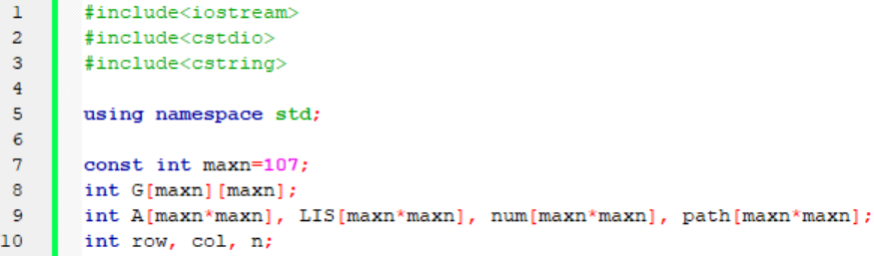
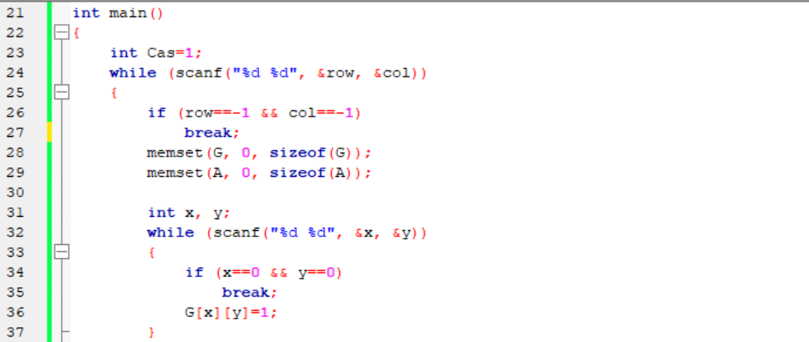

Slide 49
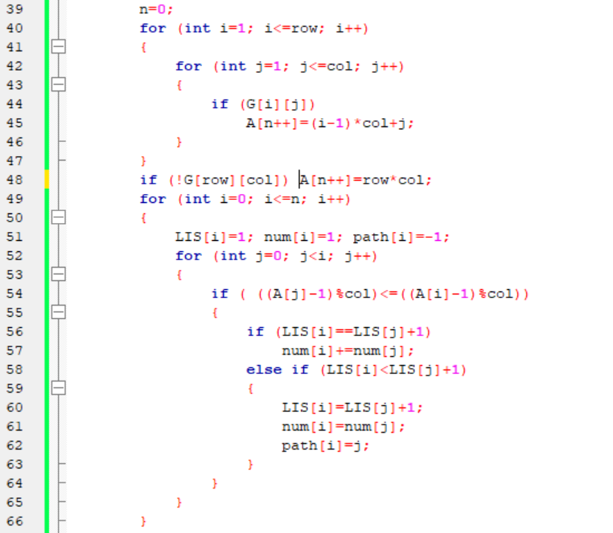

Slide 50
